Slide 1
PETA: VEGGIE LOVE
A comprehensive insight.
ENG 102-55
By:
Muhammad Arham Khan (CS)
Eldar Rahimli (MBG)

Slide 2
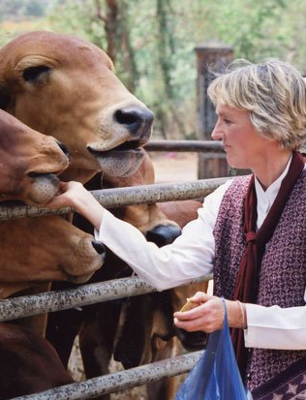
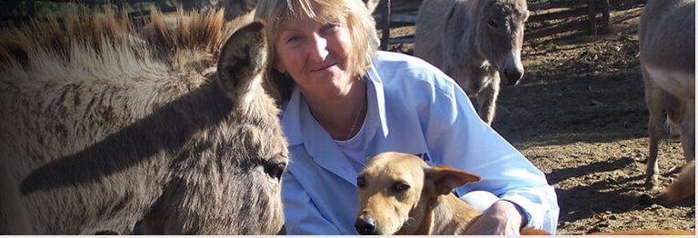
ABOUT PETA:
PETA (PEOPLE FOR THE ETHICAL TREATMENT OF ANIMALS)
Officially, worlds largest animal rights organization.
More than 6.5 million supporters/ members worldwide
Geared towards relieving animals from cruelty and killings.
Operates through public education, research and campaigns.
PETA promotes people to go VEGAN.

Slide 3


THE MESSAGE:
Implicit message: Going VEGAN is a good choice (to protect animals from slaughter).
Explicit message: VEGANS have good sex!
Visual message: several semi-naked women enjoying their time with vegetables.

Slide 4
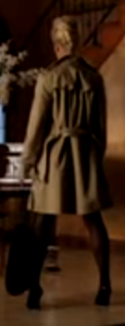
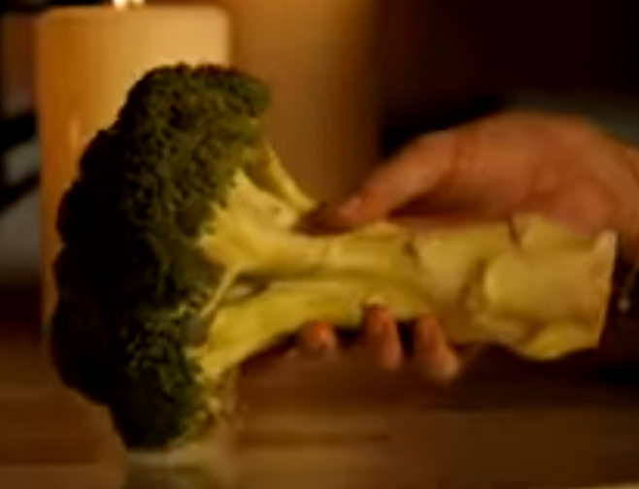
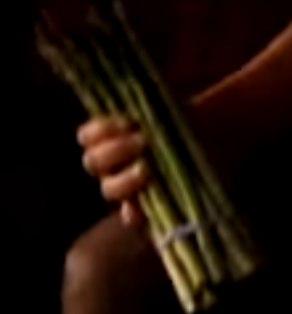
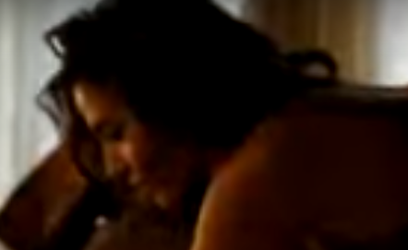
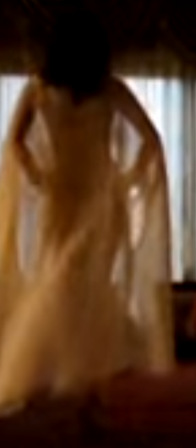
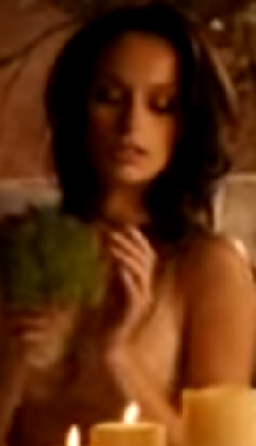
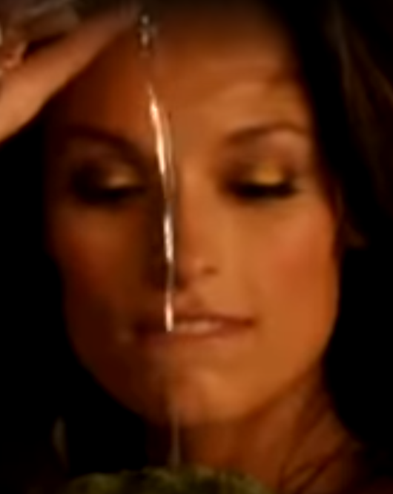
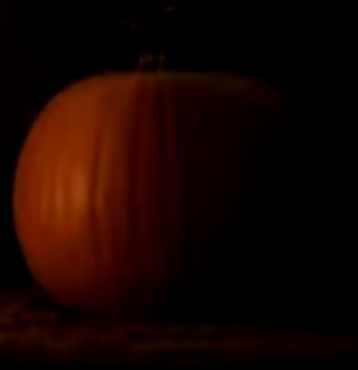
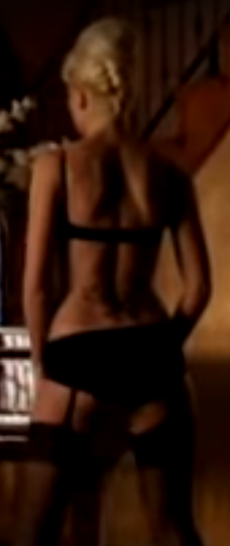
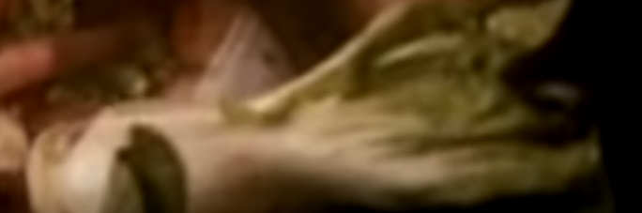
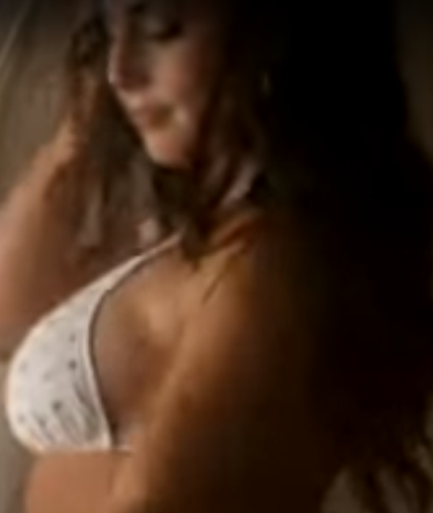
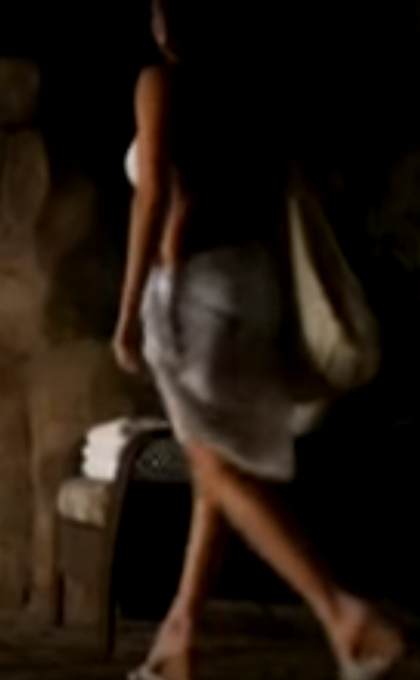
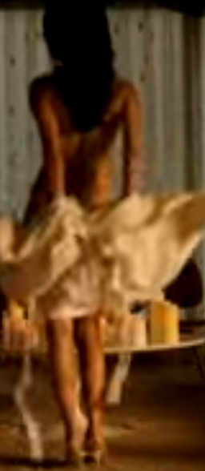
UNESCO’s GENDER SENSITIVE INDICATORS: PROPORTIONS (B2.1 - 1)
MEN
WOMEN
VEGETABLES?
?

Slide 5
UNESCO’s GENDER SENSITIVE INDICATORS: APPEARANCE/ SEXUALIZATION (B2.1- 7/10)
ALERT: HIGHLY HYPERSEXUALIZED CONTENT
All women portrayed almost naked (sexually revealing clothing)
Appearance portrayed as primary.

Slide 6
SUPPORTING STATEMENTS
“Advertising in magazines also communicates the message that women are sexual objects. While men are seldom pictured nude or even partially unclothed, women habitually are.”- Wood 1994
“Females were over five times as likely as males to be shown in sexually revealing clothing, which was defined as attire that enhances, exaggerates, or calls attention to any part of the body from neck to knees.”- Smith and Cook 2008

Slide 7
ANALYSIS (Characters)
Strategically portrays women only, no men.
Severe objectification of women (portraying them semi-naked).
Women acting in a sexually appealing manner, just to grab attention.
Irrelevant depiction of sexuality.
All the characters are white, have hypersexualized (thin, unnatural bodies)
Characters ideas and personalities not important, focuses on appearance (mere eye-candies).
Targeted towards men, because it appeals to them sexually.

Slide 8
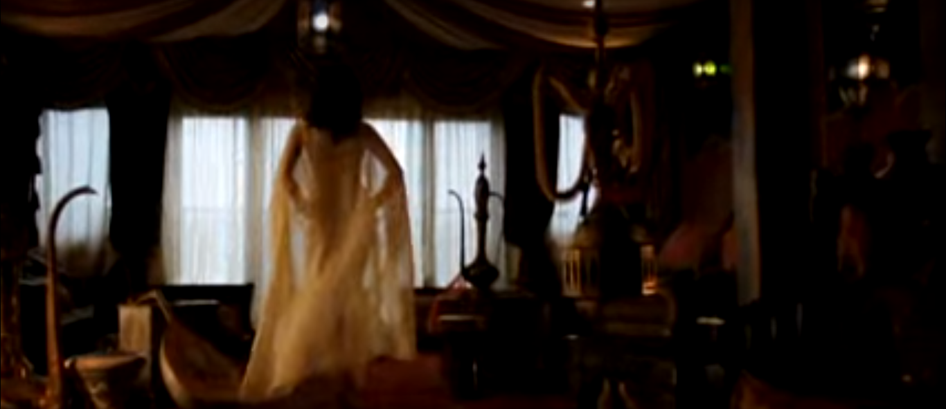
COLOR THEME ANALYSIS
-Dark, sensuous environment to portray the sexual nature of the idea
-Perfect theme to go along with the idea of sex (Dark, cozy)

Slide 9
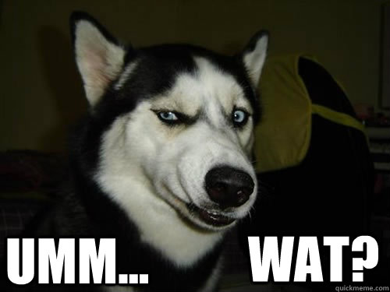
ANALYSIS (Idea) I
Shows women enjoying vegetables, a reference to women enjoying sex with vegans.
Making a relation between sex and animal rights in a very objective and illogical way (No proven connection, no statistics provided).
Major organization, instead of producing related facts, conjures a relation that appeals to the crowd.

Slide 10
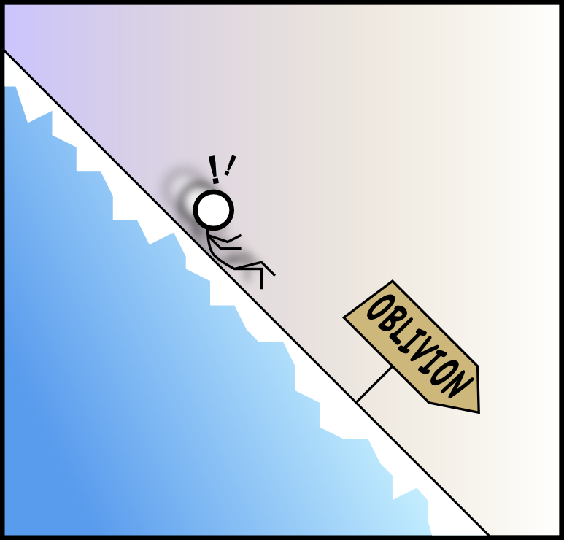

ANALYSIS (Idea) II
LOGICAL FALLACIES:
SLIPPERY SLOPE: Asserts that if people eat animals, they wont have better sex, so they shouldn’t kill/ eat animals and should go vegan.
APPEAL TO EMOTION: Tries to appeal peoples emotion (Sexual performance) to save animals. (?)
BURDEN OF PROOF: Does not provide any valid research citations to prove relation between eating vegetables, having sex and saving animals.

Slide 11
Conclusion
The ad enforces a thought that to have good sex, one must go VEGAN (no evidence)
Major problem: Objectification of women, core idea is illogical.
Minor issues: Nothing, everything is a major problem!

Slide 12
Discussion Questions
Is it effective to use sexualized females in every ad, independent of what is being advertised? Why?
What effect would sexualized females in advertisements have on viewers?

Slide 13
REFERENCES
https://www.peta.org/- PEOPLE FOR THE ETHICAL TREATMENT OF ANIMALS
Wood, Julia T. “Gendered Media.” Gendered Lives: Communication, Gender, and Culture, 1994, pp. 231–244.
Smith, Stacy L., and Crystal Allene Cook. “Gender Stereotypes.” 2008.

